Slide 1
COMPLETE
BUSINESS
STATISTICS
by
AMIR D. ACZEL
&
JAYAVEL SOUNDERPANDIAN
7th edition.
Prepared by Lloyd Jaisingh, Morehead State University
Chapter 14
Nonparametric Methods and Chi-Square Tests
McGraw-Hill/Irwin
Copyright © 2009 by The McGraw-Hill Companies, Inc. All rights reserved.

Slide 2
_{14-<number>}
14
Nonparametric Methods and Chi-Square Tests (1)
Using Statistics
The Sign Test
The Runs Test - A Test for Randomness
The Mann-Whitney U Test
The Wilcoxon Signed-Rank Test
The Kruskal-Wallis Test - A Nonparametric Alternative to One-Way ANOVA

Slide 3
_{14-<number>}
14
Nonparametric Methods and Chi-Square Tests (2)
The Friedman Test for a Randomized Block Design
The Spearman Rank Correlation Coefficient
A Chi-Square Test for Goodness of Fit
Contingency Table Analysis - A Chi-Square Test for Independence
A Chi-Square Test for Equality of Proportions

Slide 4
_{14-<number>}
14
LEARNING OBJECTIVES
After reading this chapter you should be able to:
Differentiate between parametric and nonparametric tests
Conduct a sign test to compare population means
Conduct a runs test to detect abnormal sequences
Conduct a Mann-Whitney test for comparing population distributions
Conduct a Wilcoxon test for paired differences

Slide 5
_{14-<number>}
14
LEARNING OBJECTIVES (2)
After reading this chapter you should be able to:
Conduct a Friedman’s test for randomized block designs
Compute Spearman’s Rank Correlation Coefficient for ordinal data
Conduct a chi-square test for goodness-of-fit
Conduct a chi-square test for independence
Conduct a chi-square test for equality of proportions

Slide 6
14-1 Using Statistics (Parametric Tests)
_{14-<number>}
Parametric Methods
  Inferences based on assumptions about the nature of the population distribution
    Usually: population is normal
  Types of tests
    z-test or t-test
      Comparing two population means or proportions
      Testing value of population mean or proportion
    ANOVA
      Testing equality of several population means

Slide 7
Nonparametric Tests
_{14-<number>}
Nonparametric Tests
  Distribution-free methods making no assumptions about the population distribution
  Types of tests
    Sign tests
      Sign Test: Comparing paired observations
      McNemar Test: Comparing qualitative variables
      Cox and Stuart Test: Detecting trend
    Runs tests
      Runs Test: Detecting randomness
      Wald-Wolfowitz Test: Comparing two distributions

Slide 8
Nonparametric Tests (Continued)
_{14-<number>}
Nonparametric Tests
    Ranks tests
      Mann-Whitney U Test: Comparing two populations
      Wilcoxon Signed-Rank Test: Paired comparisons
      Comparing several populations: ANOVA with ranks
        Kruskal-Wallis Test
        Friedman Test: Repeated measures
    Spearman Rank Correlation Coefficient
    Chi-Square Tests
      Goodness of Fit
      Testing for independence: Contingency Table Analysis
      Equality of Proportions

Slide 9
Nonparametric Tests (Continued)
_{14-<number>}
Deal with enumerative (frequency counts) data.
Do not deal with specific population parameters, such as the population mean or standard deviation.
Do not require assumptions about specific population distributions (in particular, the normality assumption).

Slide 10
14-2 Sign Test
_{14-<number>}
Comparing paired observations
  Paired observations: X and Y
  p = P(X > Y)
    Two-tailed test H₀: p = 0.50 H₁: p ≠ 0.50
    Right-tailed test H₀: p ≤ 0.50 H₁: p > 0.50
    Left-tailed test H₀: p ≥ 0.50 H₁: p < 0.50
    Test statistic: T = Number of + signs

Slide 11
Sign Test Decision Rule
_{14-<number>}
Small Sample: Binomial Test
  For a two-tailed test, find a critical point corresponding as closely as possible to α/2 (C₁) and define C₂ as n-C₁. Reject null hypothesis if T ≤ C₁or T ≥ C₂.
  For a right-tailed test, reject H₀ if T ≥ C, where C is the value of the binomial distribution with parameters n and p = 0.50 such that the sum of the probabilities of all values less than or equal to C is as close as possible to the chosen level of significance, α.
  For a left-tailed test, reject H₀ if T ≥ C, where C is defined as above.

Slide 12
Example 14-1
_{14-<number>}
CEO Before After Sign
1 3 4 1 +
2 5 5 0
3 2 3 1 +
4 2 4 1 +
5 4 4 0
6 2 3 1 +
7 1 2 1 +
8 5 4 -1 -
9 4 5 1 +
10 5 4 -1 -
11 3 4 1 +
12 2 5 1 +
13 2 5 1 +
14 2 3 1 +
15 1 2 1 +
16 3 2 -1 -
17 4 5 1 +
Cumulative
Binomial
Probabilities
(n=15, p=0.5)
x F(x)
0 0.00003
1 0.00049
2 0.00369
3 0.01758
4 0.05923
5 0.15088
6 0.30362
7 0.50000
8 0.69638
9 0.84912
10 0.94077
11 0.98242
12 0.99631
13 0.99951
14 0.99997
15 1.00000
n = 15 T = 12
α ≈ 0.025
C1=3 C2 = 15-3 = 12
H₀ rejected, since
T ≥ C2
C1

Slide 13
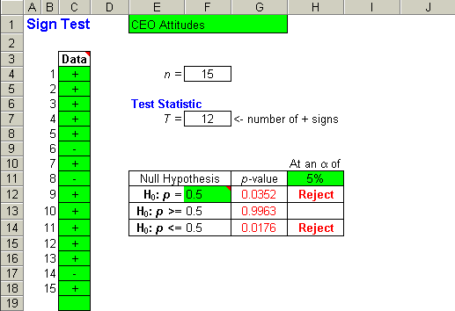
Example 14-1- Using the Template
_{14-<number>}
H₀: p = 0.5
H₁: p ≠ 0.5
Test Statistic: T = 12
p-value = 0.0352.
For α = 0.05, the null hypothesis
is rejected since 0.0352 < 0.05.
Thus one can conclude that there
is a change in attitude toward a
CEO following the award of an
MBA degree.

Slide 14
14-3 The Runs Test - A Test for Randomness
_{14-<number>}
A run is a sequence of like elements that are preceded and followed by different elements or no element at all.
Case 1: S|E|S|E|S|E|S|E|S|E|S|E|S|E|S|E|S|E|S|E : R = 20 Apparently nonrandom
Case 2: SSSSSSSSSS|EEEEEEEEEE : R = 2 Apparently nonrandom
Case 3: S|EE|SS|EEE|S|E|SS|E|S|EE|SSS|E : R = 12 Perhaps random
A two-tailed hypothesis test for randomness:
H₀: Observations are generated randomly
H₁: Observations are not generated randomly
Test Statistic:
R=Number of Runs
Reject H₀ at level α if R ≤ C1 or R ≥ C2, as given in Table 8, with total tail probability P(R ≤ C₁) + P(R ≥ C₂) = α.

Slide 15
Runs Test: Examples
_{14-<number>}
Table 8: Number of Runs (r)
(n₁,n₂) 11 12 13 14 15 16 17 18 19 20
.
.
.
(10,10) 0.586 0.758 0.872 0.949 0.981 0.996 0.999 1.000 1.000 1.000
Case 1: n₁ = 10 n₂ = 10 R= 20 p-value≈0
Case 2: n₁ = 10 n₂ = 10 R = 2 p-value ≈0
Case 3: n₁ = 10 n₂ = 10 R= 12
p-value = 2[P(R ≥ 12)] = 2[1−F(11)]
= (2)(1-0.586) = (2)(0.414) = 0.828
H₀ not rejected

Slide 16
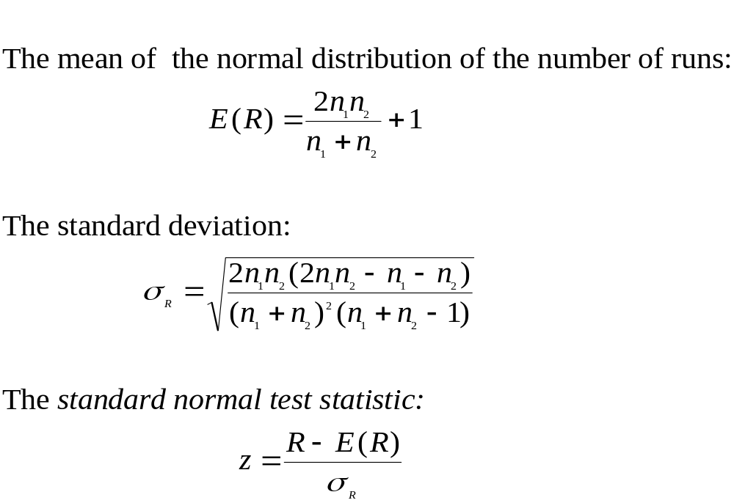
Large-Sample Runs Test: Using the Normal Approximation
_{14-<number>}

Slide 17
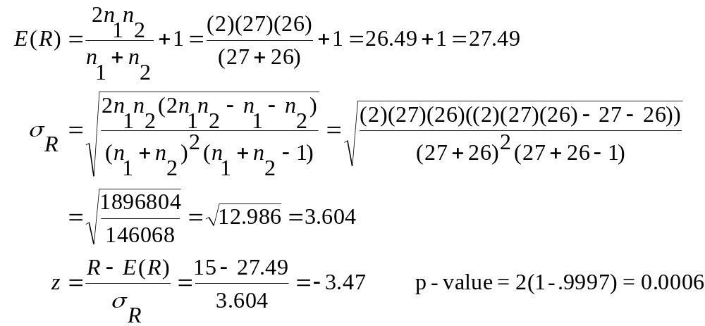
Large-Sample Runs Test: Example 14-2
_{14-<number>}
Example 14-2: n₁ = 27 n₂ = 26 R = 15
H₀ should be rejected at any common level of significance.

Slide 18
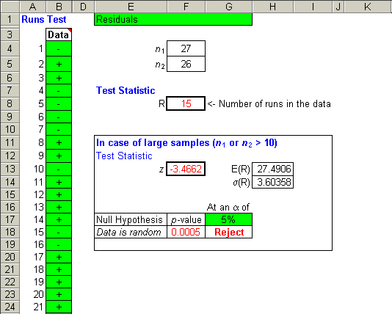
Large-Sample Runs Test: Example 14-2 – Using the Template
_{14-<number>}
Note:
The computed
p-value using the template is 0.0005 as compared to the manually computed value of 0.0006. The value of 0.0005 is more accurate.
Reject the null hypothesis that the residuals are random.

Slide 19
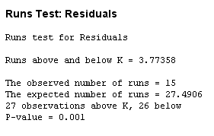
Large-Sample Runs Test: Example 14-2 – Using Minitab
_{14-<number>}
Note:
The computed
p-value using the Minitab is 0.001 as compared to the manually computed value of 0.0006. The value of 0.001 is more accurate.
Reject the null hypothesis that the residuals are random.

Slide 20
Using the Runs Test to Compare Two Population Distributions (Means): the Wald-Wolfowitz Test
_{14-<number>}
The null and alternative hypotheses for the Wald-Wolfowitz test:
H₀: The two populations have the same distribution
H₁: The two populations have different distributions
The test statistic:
R = Number of Runs in the sequence of samples, when
the data from both samples have been sorted
Example 14-3:
Salesperson A: 35 44 39 50 48 29 60 75 49 66
Salesperson B: 17 23 13 24 33 21 18 16 32

Slide 21
The Wald-Wolfowitz Test: Example 14-3
_{14-<number>}
Sales
Sales Sales Person
Sales Person (Sorted) (Sorted) Runs
35 A 13 B
44 A 16 B
39 A 17 B
48 A 21 B
60 A 24 B 1
75 A 29 A 2
49 A 32 B
66 A 33 B 3
17 B 35 A
23 B 39 A
13 B 44 A
24 B 48 A
33 B 49 A
21 B 50 A
18 B 60 A
16 B 66 A
32 B 75 A 4
n₁ = 10 n₂ = 9 R= 4
p-value = 2[P(R ≤ 4)] = 0.002
H₀ may be rejected
Table Number of Runs (r)
(n₁,n₂) 2 3 4 5
.
.
.
(9,10) 0.000 0.000 0.002 0.004 ...

Slide 22
Ranks Tests
_{14-<number>}
Ranks tests
  Mann-Whitney U Test: Comparing two populations
  Wilcoxon Signed-Rank Test: Paired comparisons
  Comparing several populations: ANOVA with ranks
    Kruskal-Wallis Test
    Friedman Test: Repeated measures

Slide 23
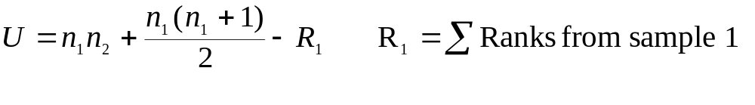
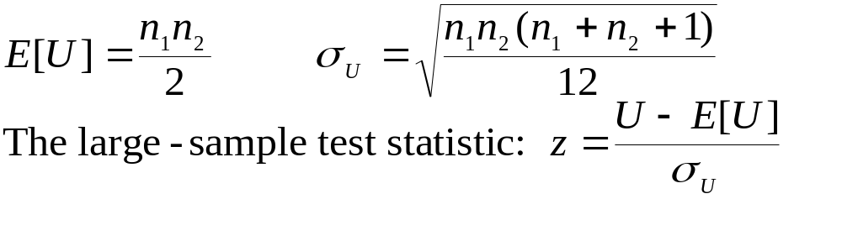
14-4 The Mann-Whitney U Test (Comparing Two Populations)
_{14-<number>}
The null and alternative hypotheses:
H₀: The distributions of two populations are identical
H₁: The two population distributions are not identical
The Mann-Whitney U statistic:
where n₁ is the sample size from population 1 and n₂ is the sample size from population 2.

Slide 24
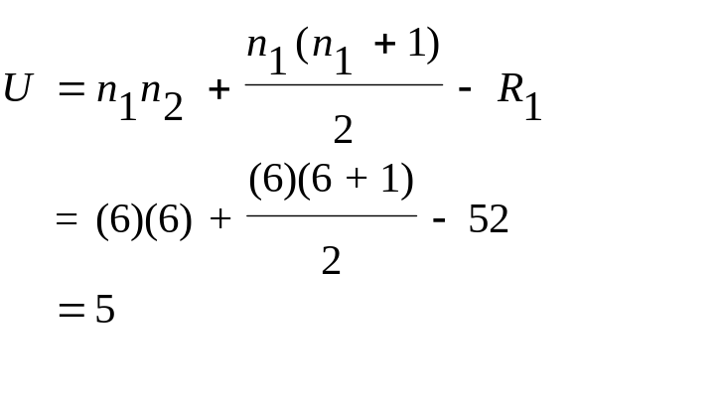
The Mann-Whitney U Test:
Example 14-4
_{14-<number>}
Rank
Model Time Rank Sum
A 35 5
A 38 8
A 40 10
A 42 12
A 41 11
A 36 6 52
B 29 2
B 27 1
B 30 3
B 33 4
B 39 9
B 37 7 26
Cumulative Distribution Function of the Mann-Whitney U Statistic
n₂=6
n₁=6
u
.
.
.
4 0.0130
5 0.0206
6 0.0325
.
.
.
P(u≤5)

Slide 25
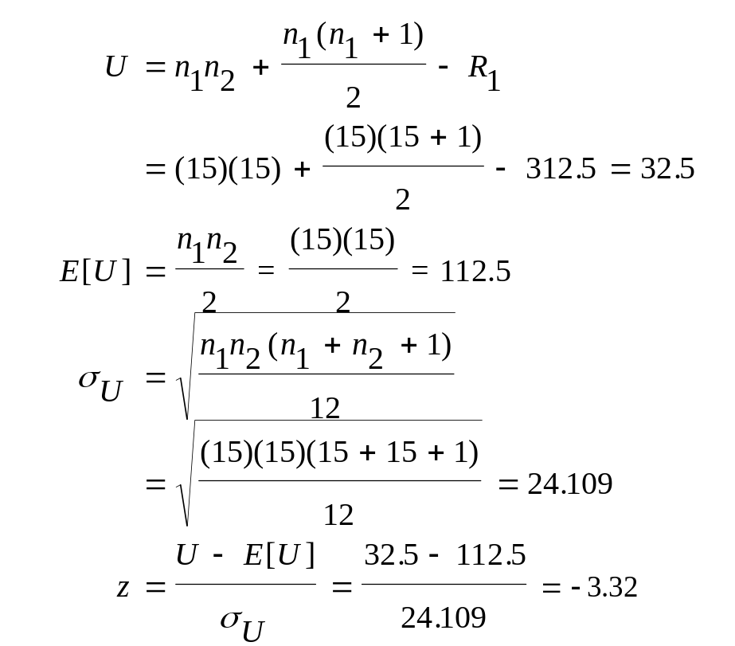
Example 14-5: Large-Sample
Mann-Whitney U Test
_{14-<number>}
Score Rank
Score Program Rank Sum
85 1 20.0 20.0
87 1 21.0 41.0
92 1 27.0 68.0
98 1 30.0 98.0
90 1 26.0 124.0
88 1 23.0 147.0
75 1 17.0 164.0
72 1 13.5 177.5
60 1 6.5 184.0
93 1 28.0 212.0
88 1 23.0 235.0
89 1 25.0 260.0
96 1 29.0 289.0
73 1 15.0 304.0
62 1 8.5 312.5
Score Rank
Score Program Rank Sum
65 2 10.0 10.0
57 2 4.0 14.0
74 2 16.0 30.0
43 2 2.0 32.0
39 2 1.0 33.0
88 2 23.0 56.0
62 2 8.5 64.5
69 2 11.0 75.5
70 2 12.0 87.5
72 2 13.5 101.0
59 2 5.0 106.0
60 2 6.5 112.5
80 2 18.0 130.5
83 2 19.0 149.5
50 2 3.0 152.5
Since the test statistic is z = -3.32,
the p-value ≈ 0.0005, and H₀ is rejected.

Slide 26
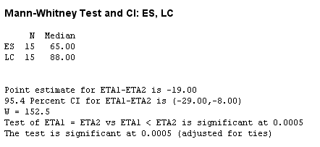
Example 14-5: Large-Sample
Mann-Whitney U Test – Using Minitab
_{14-<number>}
Since the p-value ≈ 0.0005, H₀ is rejected.
That is, the LC (Learning Curve) program is more effective.

Slide 27
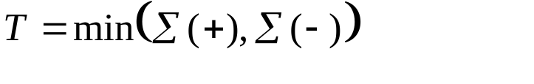
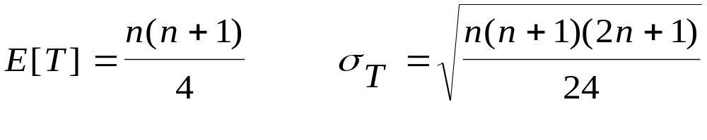
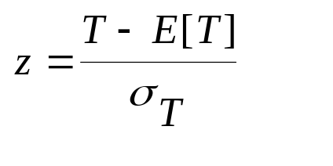
14-5 The Wilcoxon Signed-Rank Test (Paired Ranks)
_{14-<number>}
The null and alternative hypotheses:
H₀: The median difference between populations are 1 and 2 is zero
H₁: The median difference between populations are 1 and 2 is not zero
Find the difference between the ranks for each pair, D = x₁ -x₂, and then rank the absolute values of the differences.
The Wilcoxon T statistic is the smaller of the sums of the positive ranks and the sum of the negative ranks:
For small samples, a left-tailed test is used, using the values in Appendix C, Table 10.
The large-sample test statistic:

Slide 28
Example 14-6
_{14-<number>}
Sold Sold Rank Rank Rank
(1) (2) D=x₁-x₂ ABS(D) ABS(D) (D>0) (D<0)
56 40 16 16 9.0 9.0 0
48 70 -22 22 12.0 0.0 12
100 60 40 40 15.0 15.0 0
85 70 15 15 8.0 8.0 0
22 8 14 14 7.0 7.0 0
44 40 4 4 2.0 2.0 0
35 45 -10 10 6.0 0.0 6
28 7 21 21 11.0 11.0 0
52 60 -8 8 5.0 0.0 5
77 70 7 7 3.5 3.5 0
89 90 -1 1 1.0 0.0 1
10 10 0 * * * *
65 85 -20 20 10.0 0.0 10
90 61 29 29 13.0 13.0 0
70 40 30 30 14.0 14.0 0
33 26 7 7 3.5 3.5 0
Sum: 86 34
T=34
n=15
P=0.05 30
P=0.025 25
P=0.01 20
P=0.005 16
H₀ is not rejected (Note the arithmetic error in the text for store 13)

Slide 29
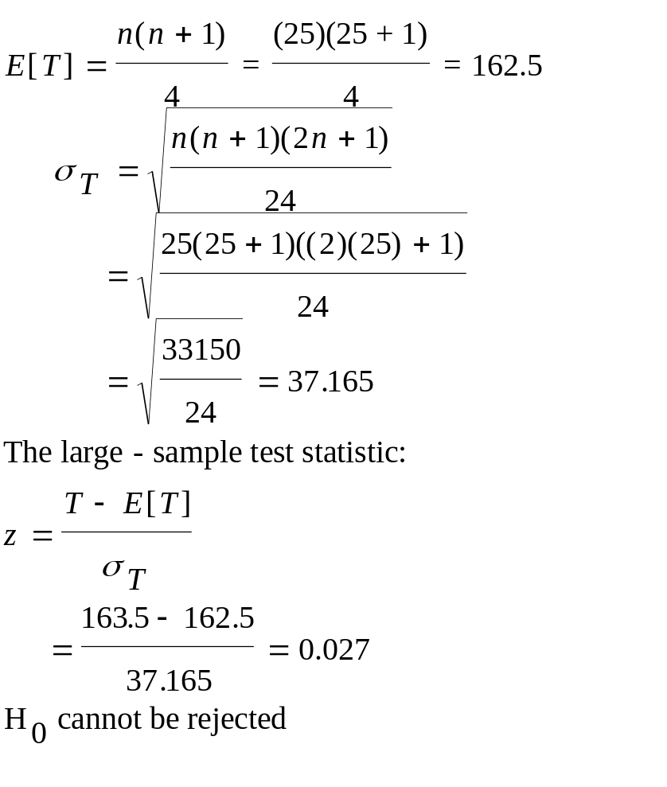
Example 14-7
_{14-<number>}
Hourly Rank Rank Rank
Messages Md₀ D=x₁-x₂ ABS(D) ABS(D) (D>0) (D<0)
151 149 2 2 1.0 1.0 0.0
144 149 -5 5 2.0 0.0 2.0
123 149 -26 26 13.0 0.0 13.0
178 149 29 29 15.0 15.0 0.0
105 149 -44 44 23.0 0.0 23.0
112 149 -37 37 20.0 0.0 20.0
140 149 -9 9 4.0 0.0 4.0
167 149 18 18 10.0 10.0 0.0
177 149 28 28 14.0 14.0 0.0
185 149 36 36 19.0 19.0 0.0
129 149 -20 20 11.0 0.0 11.0
160 149 11 11 6.0 6.0 0.0
110 149 -39 39 21.0 0.0 21.0
170 149 21 21 12.0 12.0 0.0
198 149 49 49 25.0 25.0 0.0
165 149 16 16 8.0 8.0 0.0
109 149 -40 40 22.0 0.0 22.0
118 149 -31 31 16.5 0.0 16.5
155 149 6 6 3.0 3.0 0.0
102 149 -47 47 24.0 0.0 24.0
164 149 15 15 7.0 7.0 0.0
180 149 31 31 16.5 16.5 0.0
139 149 -10 10 5.0 0.0 5.0
166 149 17 17 9.0 9.0 0.0
82 149 33 33 18.0 18.0 0.0
Sum: 163.5 161.5

Slide 30
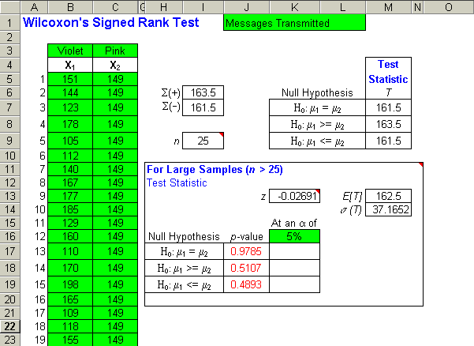
Example 14-7 using the Template
_{14-<number>}
Note 1: You should enter the claimed value of the mean (median) in every used row of the second column of data. In this case it is 149.
Note 2: In order for the large sample approximations to be computed you will need to change n > 25 to n >= 25 in cells M13 and M14.

Slide 31
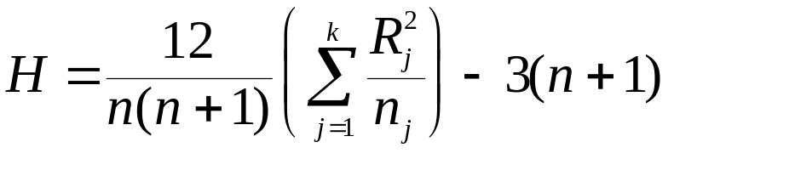
14-6 The Kruskal-Wallis Test - A Nonparametric Alternative to One-Way ANOVA
_{14-<number>}
The Kruskal-Wallis hypothesis test:
H₀: All k populations have the same distribution
H₁: Not all k populations have the same distribution
The Kruskal-Wallis test statistic:
If each n_{j} > 5, then H is approximately distributed as a χ².

Slide 32
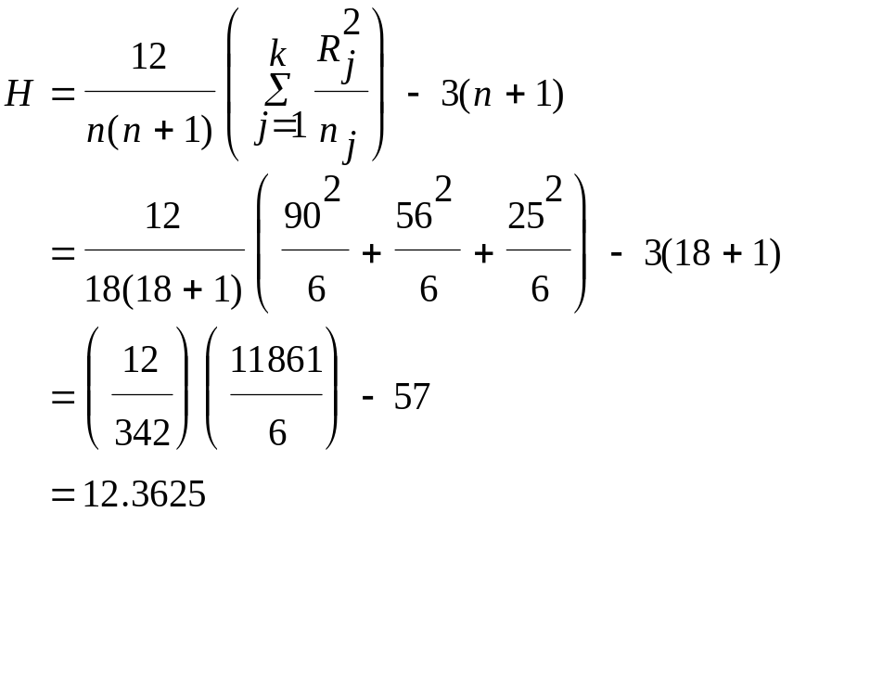
Example 14-8: The Kruskal-Wallis Test
_{14-<number>}
Software Time Rank Group RankSum
1 45 14 1 90
1 38 10 2 56
1 56 16 3 25
1 60 17
1 47 15
1 65 18
2 30 8
2 40 11
2 28 7
2 44 13
2 25 5
2 42 12
3 22 4
3 19 3
3 15 1
3 31 9
3 27 6
3 17 2
χ²_{(2,0.005)}=10.5966, so H₀ is rejected.

Slide 33
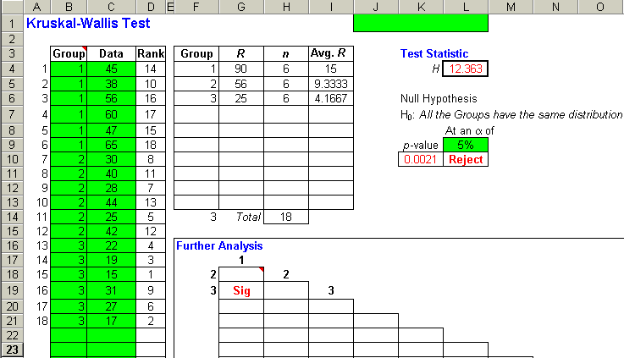
Example 14-8: The Kruskal-Wallis Test – Using the Template
_{14-<number>}
P-Value = 0.0021 so
Reject H₀

Slide 34
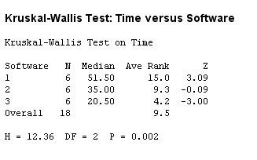
Example 14-8: The Kruskal-Wallis Test – Using Minitab
_{14-<number>}
P-Value = 0.002 so
Reject H₀

Slide 35
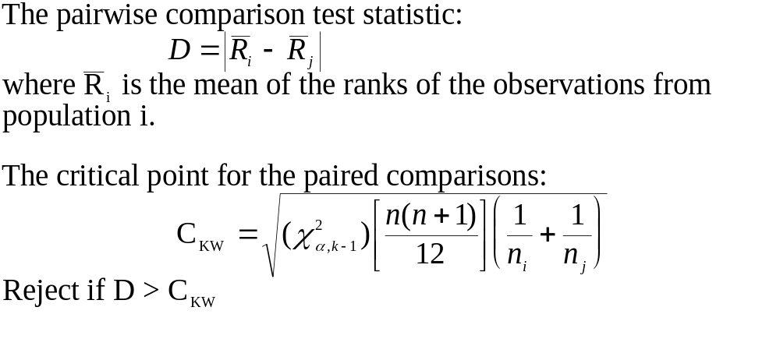
Further Analysis (Pairwise Comparisons of Average Ranks)
_{14-<number>}
If the null hypothesis in the Kruskal-Wallis test is rejected, then we may wish, in addition, compare each pair of populations to determine which are different and which are the same.

Slide 36
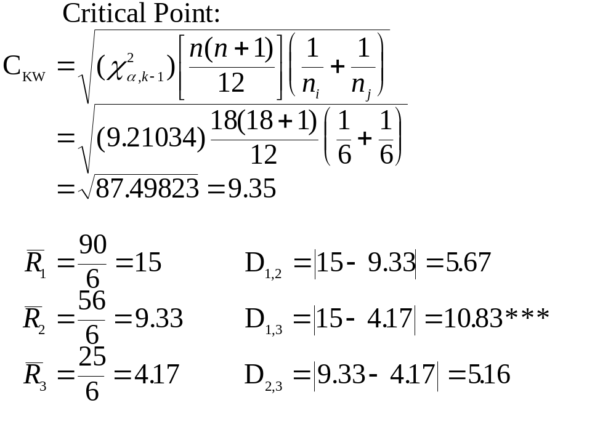
Pairwise Comparisons: Example 14-8
_{14-<number>}

Slide 37
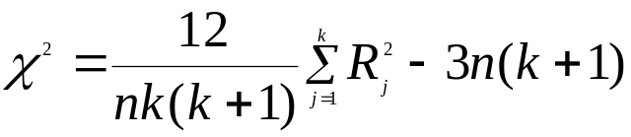
14-7 The Friedman Test for a Randomized Block Design
_{14-<number>}
The Friedman test is a nonparametric version of the randomized block design ANOVA. Sometimes this design is referred to as a two-way ANOVA with one item per cell because it is possible to view the blocks as one factor and the treatment levels as the other factor. The test is based on ranks.
The Friedman hypothesis test:
H₀: The distributions of the k treatment populations are identical
H₁: Not all k distribution are identical
The Friedman test statistic:
The degrees of freedom for the chi-square distribution is (k – 1).

Slide 38
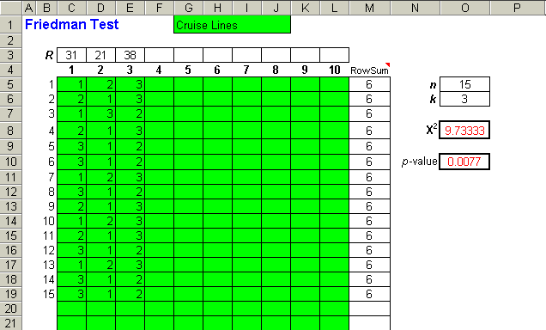
Example 14-10 – Using the Template
_{14-<number>}
Note: The p-value is small relative to a significance level of α = 0.05, so one should conclude that there is evidence that not all three low-budget cruise lines are equally preferred by the frequent cruiser population

Slide 39
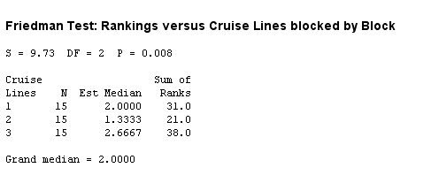
Example 14-10 – Using Minitab
_{14-<number>}
Note: The p-value is small relative to a significance level of α = 0.05, so one should conclude that there is evidence that not all three low-budget cruise lines are equally preferred by the frequent cruiser population

Slide 40
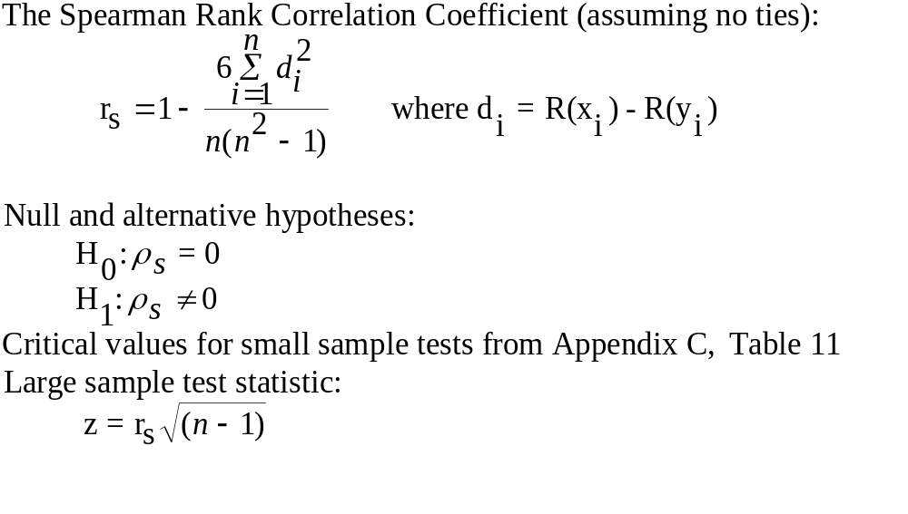
14-8 The Spearman Rank Correlation Coefficient
_{14-<number>}
The Spearman Rank Correlation Coefficient is the simple correlation coefficient calculated from variables converted to ranks from their original values.

Slide 41
Spearman Rank Correlation Coefficient: Example 14-11
_{14-<number>}
MMI S&P100 R-MMI R-S&P Diff Diffsq
220 151 7 6 1 1
218 150 5 5 0 0
216 148 3 3 0 0
217 149 4 4 0 0
215 147 2 2 0 0
213 146 1 1 0 0
219 152 6 7 -1 1
236 165 9 10 -1 1
237 162 10 9 1 1
235 161 8 8 0 0
Sum: 4
Table 11: α=0.005
n
.
.
.
7 ------
8 0.881
9 0.833
10 0.794
11 0.818
.
.
.
n
2
6
∑
d
i
i
=
(6)(4)
24
r
=
1
−
1
=
1
-
=
1
-
=
0.9758
>
0.794
H
rejected
s
2
2
990
0
n
(
n
−
1
)
(10)(10
-
1)

Slide 42
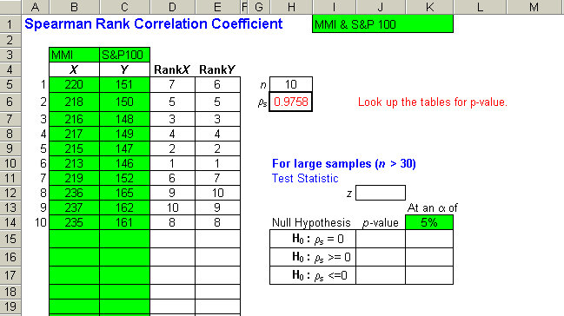
Spearman Rank Correlation Coefficient: Example 14-11 Using the Template
_{14-<number>}
Note:
The p-values in the range J15:J17 will appear only if the sample size is large (n > 30)

Slide 43
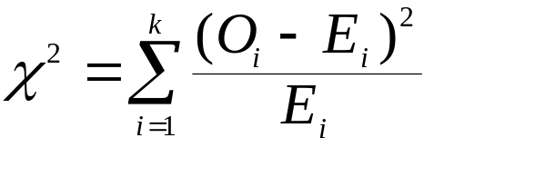
14-9 A Chi-Square Test for
Goodness of Fit
_{14-<number>}
Steps in a chi-square analysis:
  Formulate null and alternative hypotheses
  Compute frequencies of occurrence that would be expected if the null hypothesis were true - expected cell counts
  Note actual, observed cell counts
  Use differences between expected and actual cell counts to find chi-square statistic:
  Compare chi-statistic with critical values from the chi-square distribution (with k-1 degrees of freedom) to test the null hypothesis

Slide 44
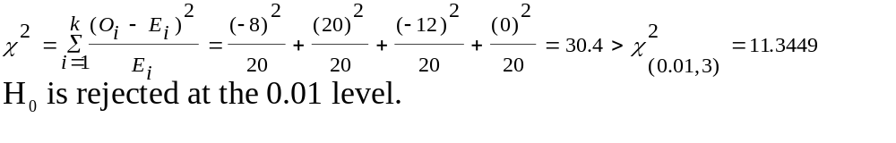
Example 14-12: Goodness-of-Fit Test for the Multinomial Distribution
_{14-<number>}
The null and alternative hypotheses:
H₀: The probabilities of occurrence of events E₁, E₂...,E_{k} are given by
p₁,p₂,...,p_{k}
H₁: The probabilities of the k events are not as specified in the null
hypothesis
Assuming equal probabilities, p₁= p₂ = p₃ = p₄ =0.25 and n=80
Preference Tan Brown Maroon Black Total
Observed 12 40 8 20 80
Expected(np) 20 20 20 20 80
(O-E) -8 20 -12 0 0

Slide 45
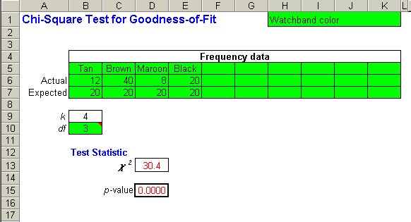
Example 14-12: Goodness-of-Fit Test for the Multinomial Distribution using the Template
_{14-<number>}
Note:
the p-value is 0.0000, so we can reject the null hypothesis at any α level.

Slide 46
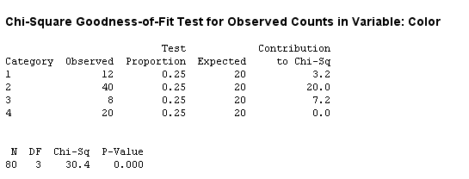
Example 14-12: Goodness-of-Fit Test for the Multinomial Distribution using Minitab
_{14-<number>}
Note:
the p-value is 0.0000, so we can reject the null hypothesis at any α level.

Slide 47
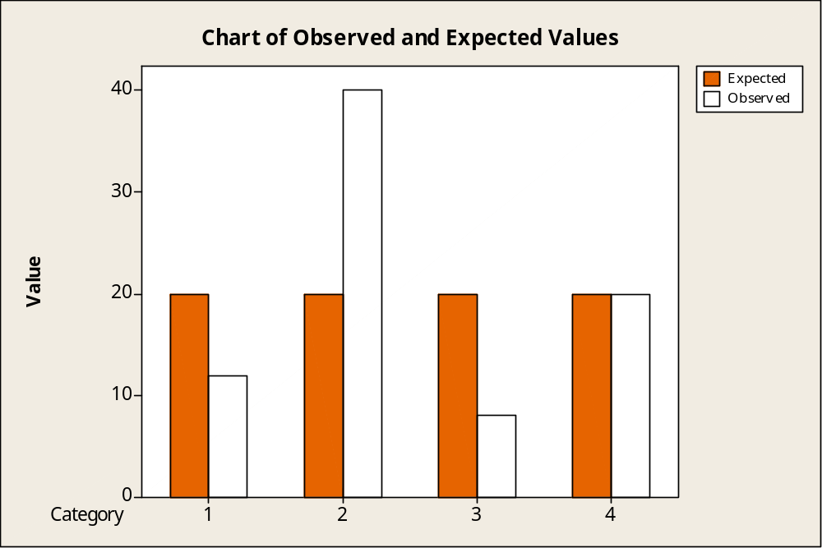
Example 14-12: Goodness-of-Fit Test for the Multinomial Distribution using Minitab
_{14-<number>}

Slide 48
Goodness-of-Fit for the Normal Distribution: Example 14-13
_{14-<number>}
1. Use the table of the standard normal distribution to determine an appropriate partition of the standard normal distribution which gives ranges with approximately equal percentages.
p(z<-1) = 0.1587
p(-1<z<-0.44) = 0.1713
p(-0.44<z<0) = 0.1700
p(0<z<0.44) = 0.1700
p(0.44<z<14) = 0.1713
p(z>1) = 0.1587
P
a
r
t
i
t
i
o
n
i
n
g
t
h
e
S
t
a
n
d
a
r
d
N
o
r
m
a
l
D
i
s
t
r
i
b
u
t
i
o
n
0.1700
0.1700
0
.
4
0.1713
0.1713
0
.
3
)
z
0
0.1587
0.1587
.
(
2
f
0
.
1
0
z
.
0
1
-
-1
5
0
5
-0.44
0.44
2. Given z boundaries, x boundaries can be determined from the inverse standard normal transformation: x = μ + σz = 125 + 40z.
3. Compare with the critical value of the χ² distribution with k-3 degrees of freedom.

Slide 49
Example 14-13: Solution
_{14-<number>}
i O_{i} E_{i} O_{i} - E_{i} (O_{i} - E_{i})² (O_{i} - E_{i})²/ E_{i}
1 14 15.87 -1.87 3.49690 0.22035
2 20 17.13 2.87 8.23691 0.48085
3 16 17.00 -1.00 1.00000 0.05882
4 19 17.00 2.00 4.00000 0.23529
5 16 17.13 -1.13 1.27690 0.07454
6 15 15.87 -0.87 0.75690 0.04769
χ²: 1.11755
χ²_{(0.10,k-3)}= 6.5139 > 1.11755 ⇒ H₀ is not rejected at the 0.10 level

Slide 50
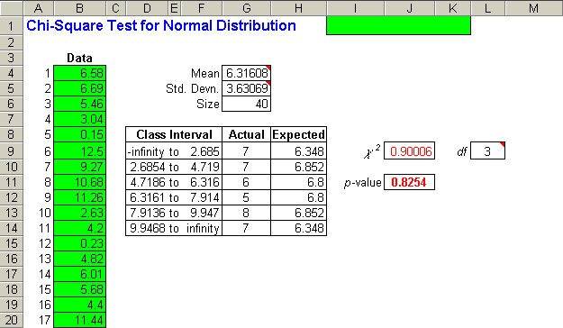
Example 14-13: Solution using the Template
_{14-<number>}
Note: p-value = 0.8254 > 0.01 ⇒ H₀ is not rejected at the 0.10 level

Slide 51
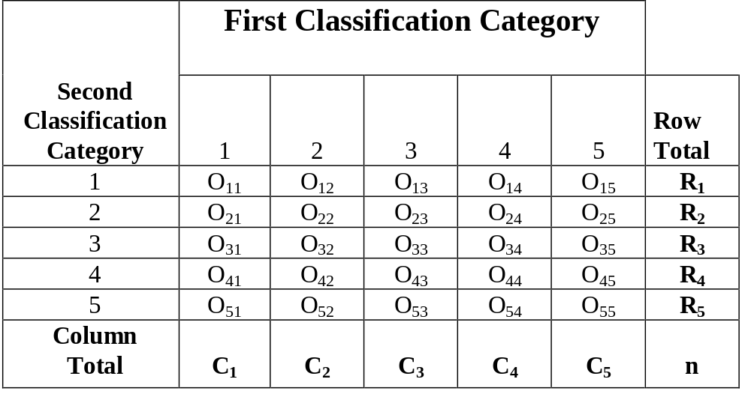
14-9 Contingency Table Analysis:
A Chi-Square Test for Independence
_{14-<number>}

Slide 52
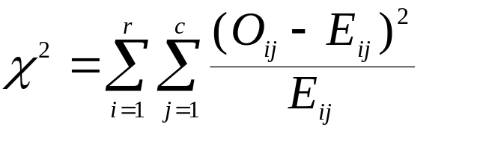
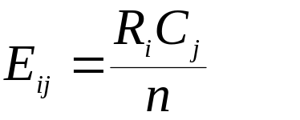
Contingency Table Analysis:
A Chi-Square Test for Independence
_{14-<number>}
A and B are independent if:P(A ∩ B) = P(A)×P(B).
If the first and second classification categories are independent:E_{ij} = (R_{i})(C_{j})/n
Null and alternative hypotheses:
H₀: The two classification variables are independent of each other
H₁: The two classification variables are not independent
Chi-square test statistic for independence:
Degrees of freedom: df=(r-1)(c-1)
Expected cell count:

Slide 53
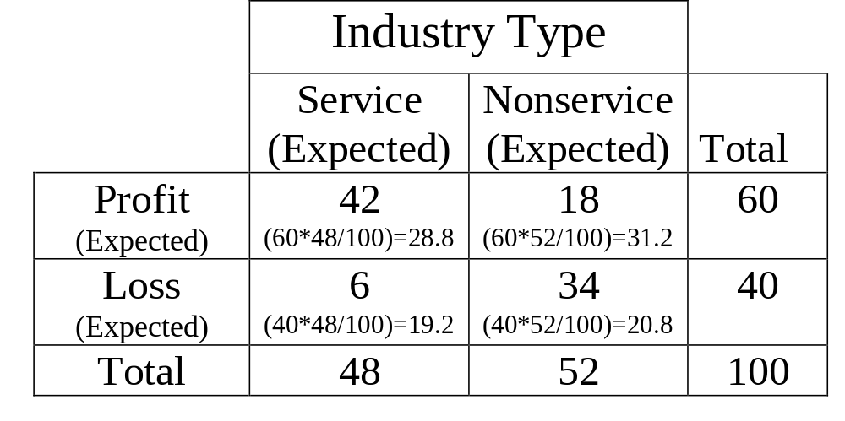
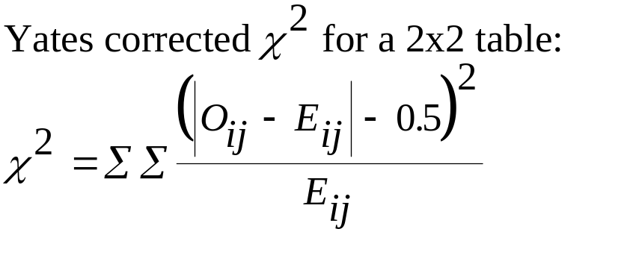
Contingency Table Analysis:
Example 14-14
_{14-<number>}
χ²_{(0.01,(2-1)(2-1))}=6.63490
H₀ is rejected at the 0.01 level and
it is concluded that the two variables
are not independent.
ij O E O-E (O-E)² (O-E)²/E
11 42 28.8 13.2 174.24 6.0500
12 18 31.2 -13.2 174.24 5.5846
21 6 19.2 -13.2 174.24 9.0750
22 34 20.8 13.2 174.24 8.3769
χ²: 29.0865

Slide 54
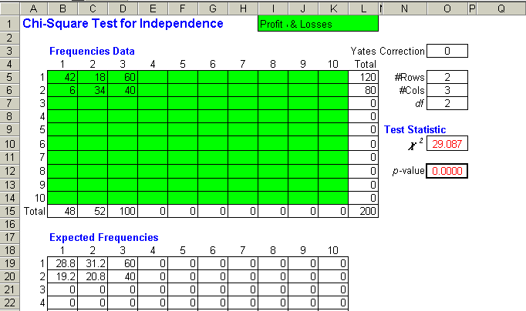
Contingency Table Analysis: Example 14-14 using the Template
_{14-<number>}
Note:
When the contingency table is a 2x2, one should use the Yates correction.
Since p-value = 0.000, H₀ is rejected at the 0.01 level and it is concluded that the two variables are not independent.

Slide 55
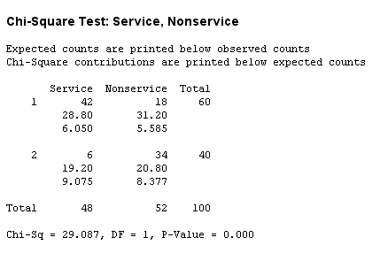
Contingency Table Analysis: Example 14-14 using Minitab
_{14-<number>}
Since p-value = 0.000, H₀ is rejected at the 0.01 level and it is concluded that the two variables are not independent.

Slide 56
14-11 Chi-Square Test for Equality of Proportions
_{14-<number>}
Tests of equality of proportions across several populations are also called tests of homogeneity.
In general, when we compare c populations (or r populations if they are arranged as rows rather than columns in the table), then the Null and alternative hypotheses:
H₀: p₁ = p₂ = p₃ = … = p_{c}
H₁: Not all p_{i}, I = 1, 2, …, c, are equal
Chi-square test statistic for equal proportions:
Degrees of freedom: df = (r-1)(c-1)
Expected cell count:

Slide 57
14-11 Chi-Square Test for Equality of Proportions - Extension
_{14-<number>}
The Median Test
Here, the Null and alternative hypotheses are:
H₀: The c populations have the same median
H₁: Not all c populations have the same median

Slide 58
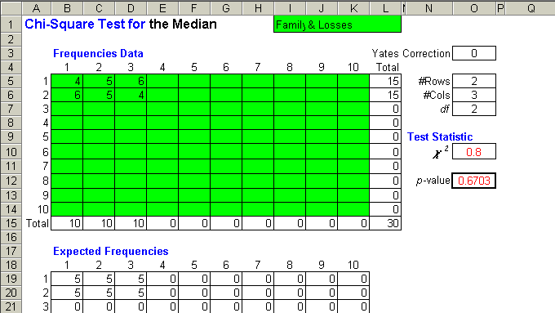
Chi-Square Test for the Median: Example 14-16 Using the Template
_{14-<number>}
Note: The template was used to help compute the test statistic and the p-value for the median test. First you must manually compute the number of values that are above the grand median and the number that is less than or equal to the grand median. Use these values in the template. See Table 14-16 in the text.
Since the p-value = 0.6703 is very large there is no evidence to reject the null hypothesis.

Slide 59
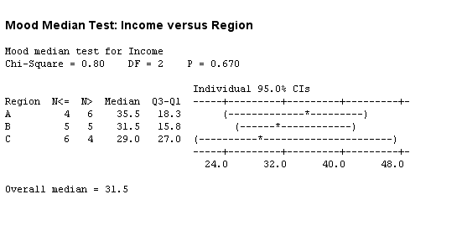
Chi-Square Test for the Median: Example 14-16 Using Minitab
_{14-<number>}
Since the
p-value = 0.6703
is very large there
is no evidence to
reject the
null hypothesis.

